Slide 1

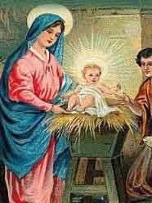

Christmas
In Great Britain and in Ukraine
By Irina Dmitrenko

Slide 2
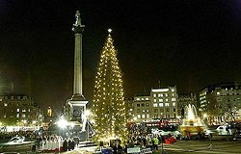
Every year there is a very big Christmas tree in the centre of London in Trafalgar Square

Slide 3
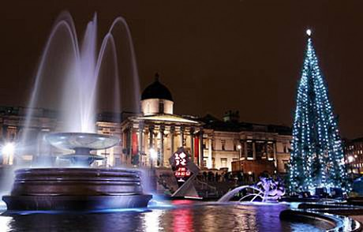
This is a present from the people of Norway to the people of Great Britain. They send it to Londoners every year and Londoners decorate the Christmas tree.

Slide 4
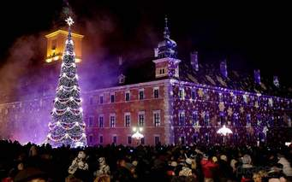
In the evening before Christmas people like to come to Trafalgar Square to look at the tree.

Slide 5
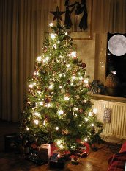
People buy a Christmas tree and decorate it with toys, coloured balls and little coloured lights. On Christmas Eve people put their presents under the tree.

Slide 6
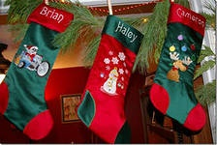
When children go to bed, they put their stockings near their beds

Slide 7
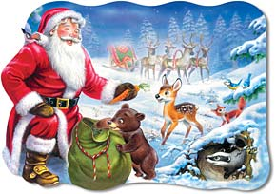
At night Santa Claus comes. He has got a big bag of presents for children.

Slide 8
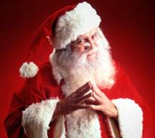


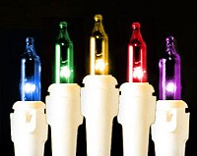
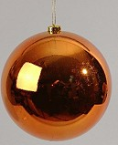
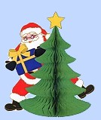
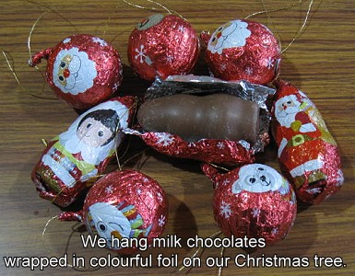
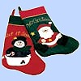
He puts the presents into the children’s stockings

Slide 9


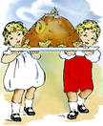
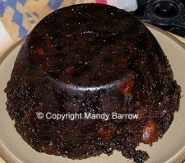

The symbols of the Christmas:

Slide 10
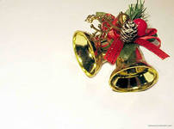
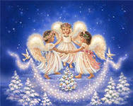
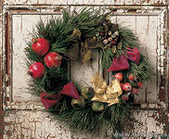
The symbols of the Christmas:

Slide 11


Christmas tree
Christmas tree is a part and parcel of the holiday. It is believed that it brings good luck.

Slide 12
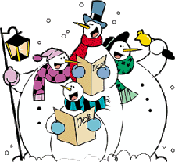

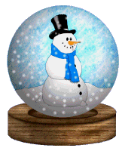
Celebration
For people all over the world Christmas is a season of giving and receiving presents. People go from house to house to sing Christmas carols.

Slide 13

This song is one of the most famous at Christmas
Dashing through the snow
In a one-horse open sleigh
Over the fields we go
Laughing all the way.
Jingle bells
Jingle bells, jingle bells!
Jingle all the way
Oh! What fun it is to ride
In a one-horse open sleigh!
Bells on bob-tail ring
Making spirits bright,
What fun it is to ride and sing
A sleighing song tonight!

Slide 14
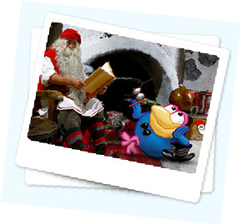
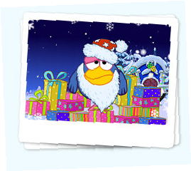
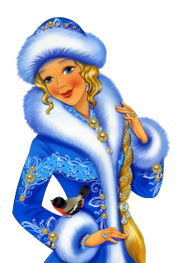
And what about Ukraine?
In Ukraine Christmas isn’t too much popular, for example, like in the UK. In our country the main holiday is New Year. We celebrate it on the 31st of December. Children wait for Did Moroz and Sniguron`ka, who bring presents
for them.

Slide 15

We wish you Happiness and Joy... And Blessings for Christmas

Slide 16


